Slide 1
The Great Nature
By: Parth Patel

Slide 2
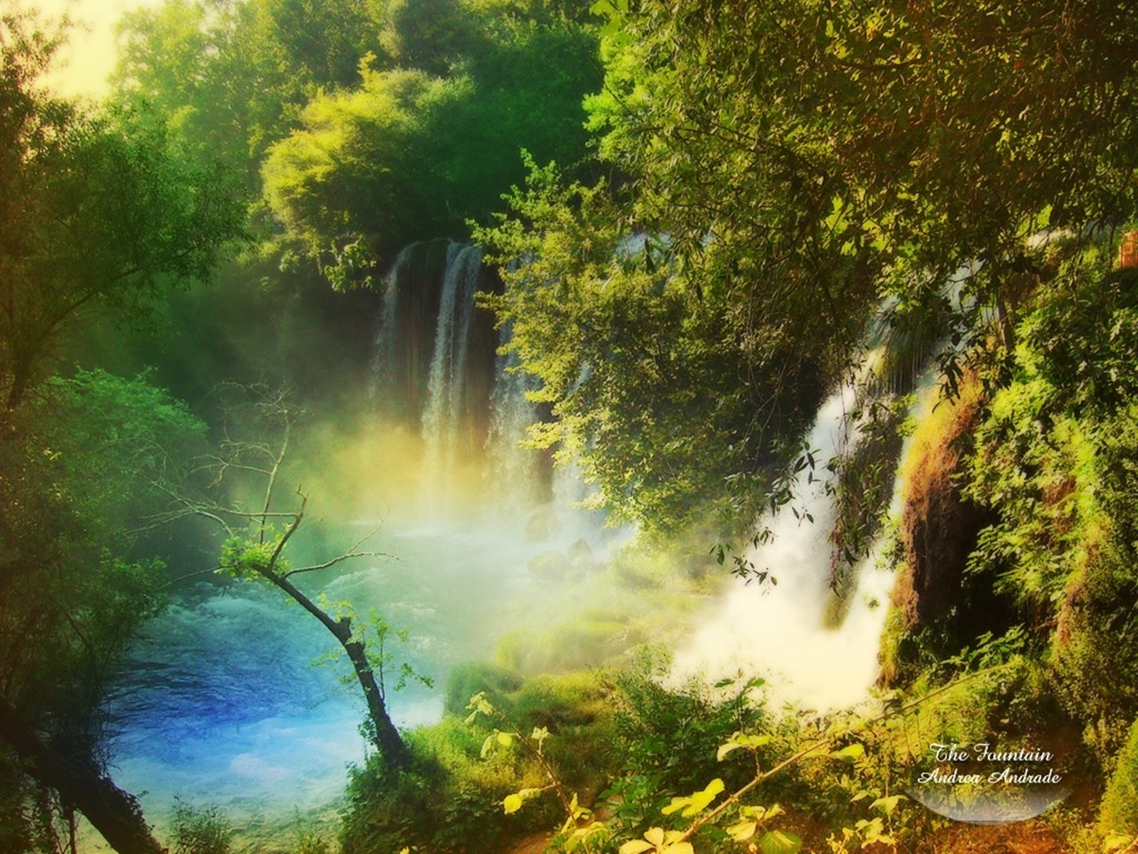
Nature is the most precious, and wonderful gift god has gave us. Nothing that man created can be prefect as the nature. We humans, are destroying the gift that god has gave us, without even realizing it. We harm in ways we human never think we could, be simply starting a small fire, the planes , vehicles we drive and ride, and also cutting doing trees.

Slide 3
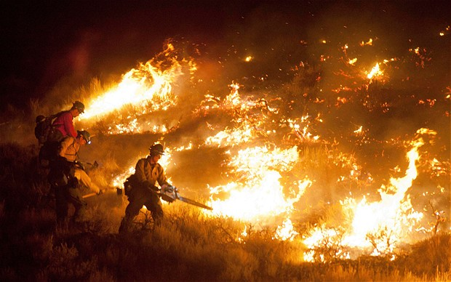
We can cause fire like this or even small, either way it is harming the nature. Fires like these cause irreparable damages to the forest and the entire nature. The fire injuries the animals or by altering wildlife habitat. Also the fire transfer heart into the soil changing the vegetation and dynamics of nutrients and organic matter. Fire also effect plants by changing resources availability. These effects translate into vegetation changes at the plant, population, and community level.

Slide 4
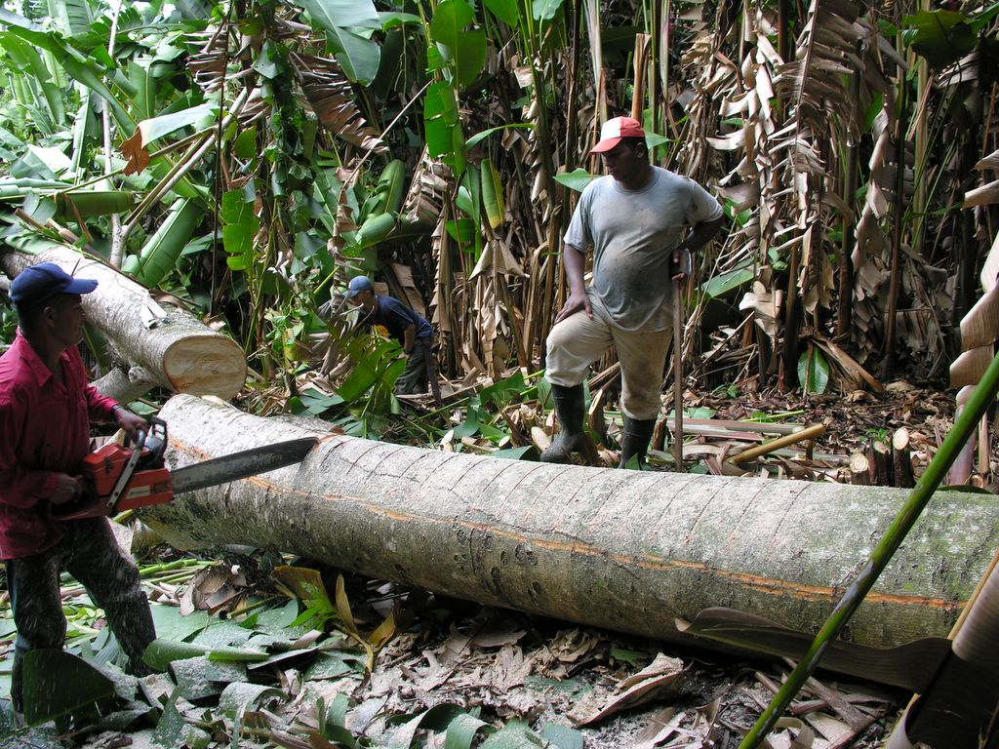
The promiscuously cutting down trees also cause huge damages. This leads to endangering some animal species to become extinct. Cutting down trees can destroys homes for some animals such as monkeys, squirrels, birds, snakes, owl, and many more.

Slide 5
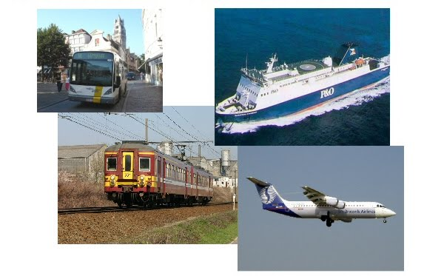
The transport is among the great pollutants of the nature. Vehicles, planes, ships, and planes discard harmful substances, which go from the air into the soil and could affect the plants. We tend to use more transportation every year. They give off certain particles that causes to change the habit of the plant life, destroying our nature.

Slide 6
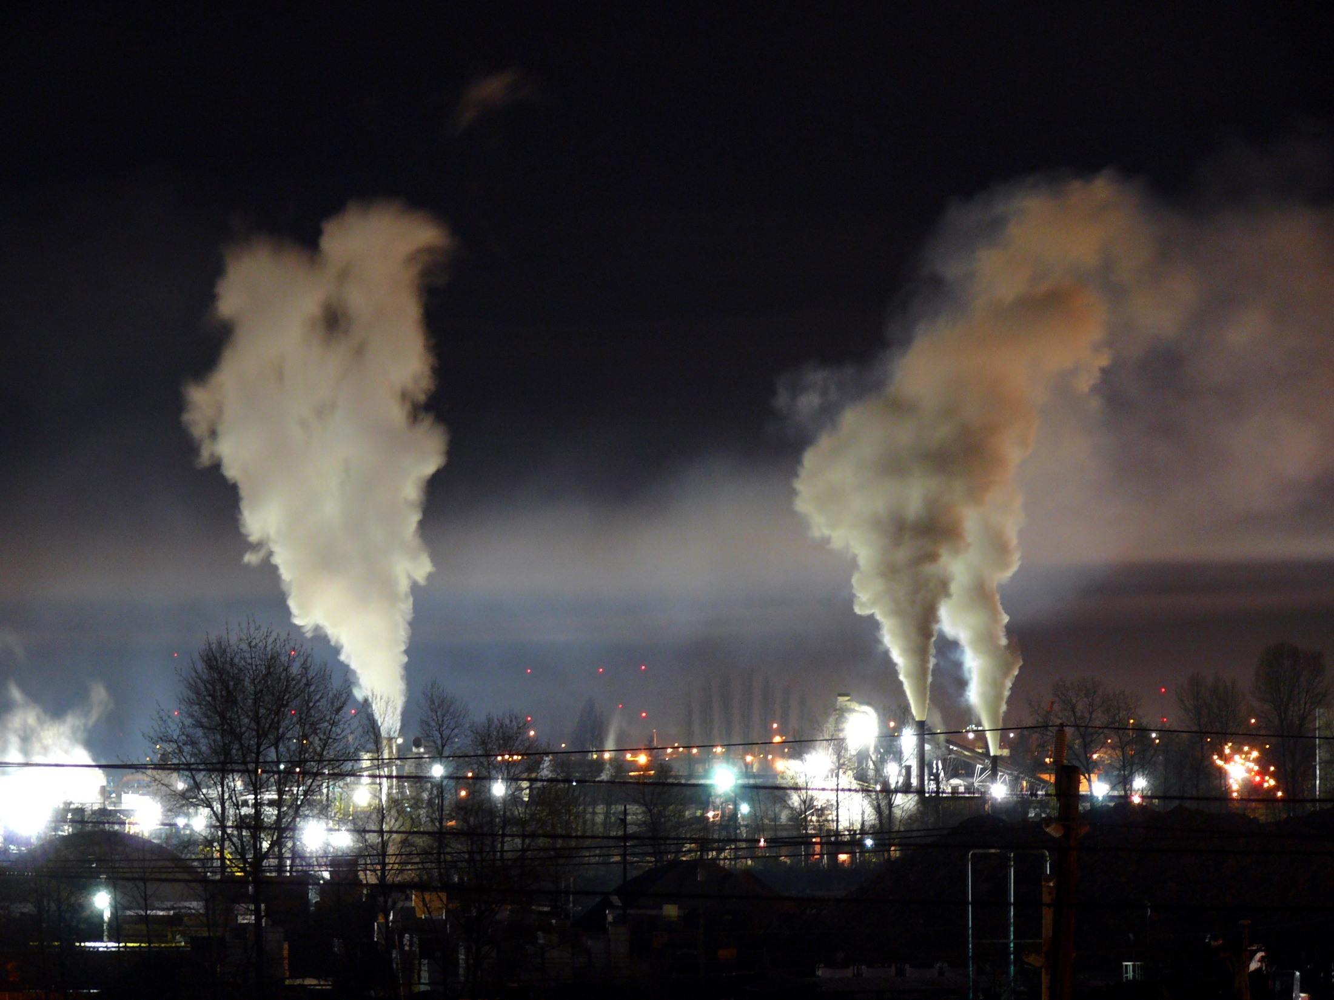
Industrial companies discard pollution substances into the air and the water. Once discarded these substances go into the air, but could also pollute the soil by the contaminated water. This has became such a serious problem with the introduction of the steam engine and a series of technological advances that led to production of goods shifting from homes and small factories to large industrial factories. Since the advancement in industrial and technological, the nature has deteriorated and result in an increased incidence of diseases and ailments.

Slide 7
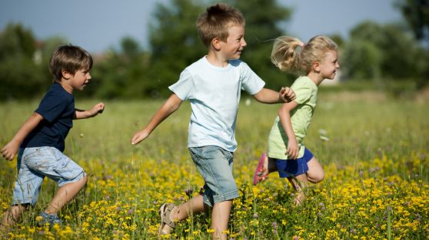
People more and more become aware of the necessity of preserving the environment. Different activities for its recovery and preserving are carried out. The contaminated water is being purified in special stations. After that its poured out again in the rivers, so it could be used for irrigation. When we preserve the nature, we preserve our own environment, water, plants and also animals. Our health and life depend on the cleanness of the nature.

Slide 8
The End

