Slide 1
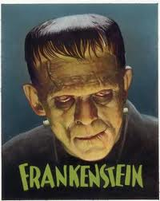
Frankenstein Legend in Literature
By: Brent Harris, Kirsten Hunt, Katelyn Newman and Katelyn Pendley

Slide 2
The Bride of Frankenstein By: Edward Field
Poem
Author
Written in 1935
Begins with the creation of the “bride”
“Bride” commits suicide
Ends with the fate of the “groom”
Born in Brooklyn, NY on June 7th, 1924
Served in World War II (began writing poems)
Received Shelley Memorial Award and an Academy Award

Slide 3
Oh, My Darling Frankenstein By: Ken Nesbitt
Poem
Author
Published in 2005
Summarizes the story of Frankenstein in a way that is understandable for children
Born in Berkeley, CA on Feb. 20th, 1962
Writes humorous children’s poems
Poems published in magazines and textbooks

Slide 4
Frankenstein Makes a Sandwich By: Adam Rex
Short Story
Author
Published in 2006
Collection of short stories with various monsters
Frankenstein is hungry and uses the food the villagers throw at him to make a sandwich
Born in Phoenix, AZ on May 16th, 1973
Began painting at age 11
Graduated from Univ. of Arizona
Writes “monster” based books

Slide 5
Frank- A Halloween Short Story By: Paul Lidais
Short Story
Author
Published in 2006
A young boy, Frank, lives with his uncle, Dr. Frankenstein
Frank is attacked by villagers
Frank is actually the ‘monster” although he plays football at Notre Dame
Lives in Central Pennsylvania
Writes short fiction during spare time
Plans to write a novel

Slide 6
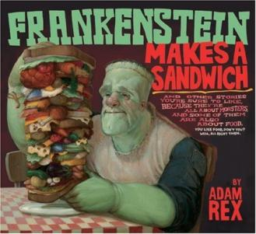
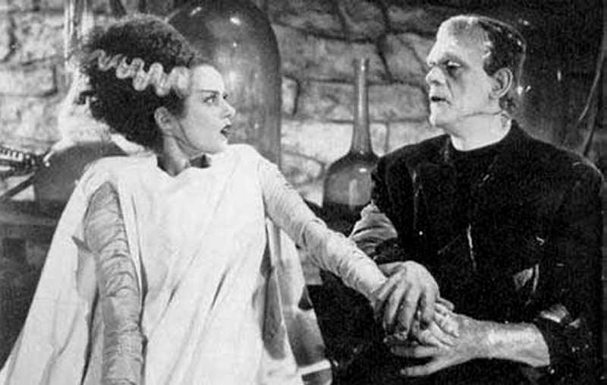
The End!

