Slide 1
Unimaginable Destruction
Trevor Walton
English IV
3rd Block

Slide 2
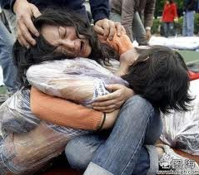
This woman will never be the same just because of an earthquake that she had no control over. I would never put anyone through the pain of losing someone in a natural disaster. It would be the equivalent of losing someone in an accident. We live in a cruel world where cruel things happen. Most people will never experience this pain and the lucky people that will not lose a loved one this way should be grateful.

Slide 3
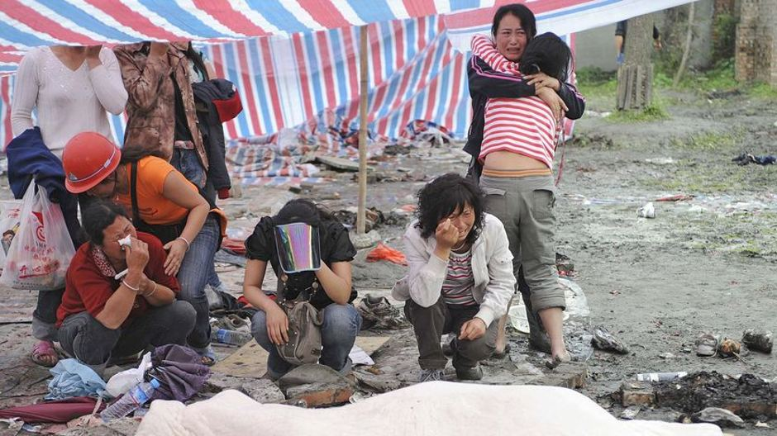
People like this have most likely never done anything to deserve this pain in their lives. Yet they have to mourn their dead just because of chance.

Slide 4
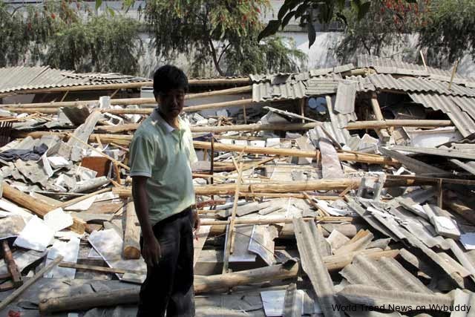
Destruction is an odd thing to talk about I know but it must be addressed. Most of the time people that discuss earthquakes or any natural disaster they talk about relief efforts and direct family references. I am here to tell you just about the effects of destruction on everyone that is involved.

Slide 5
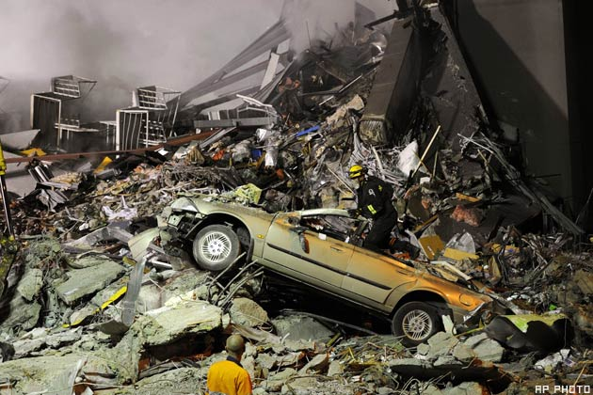
I want you to imagine in the middle of the day feeling the earth below you begin to shake and move. Something most people never experience I imagine that it would be extremely terrifying. The fact that the ground below you could split and swallow you whole is a thought that could make your spine tingle.

Slide 6
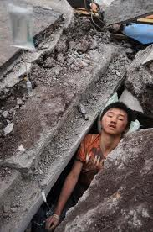
If you can imagine losing everything you know (and even love in some cases) in one day. Then I believe you could realize how the people that are effected by this horrifying experience feel. I know that I could not even fathom the idea of one day being normal and the next day having absolutely nothing in my life. It is just unthinkable.

Slide 7
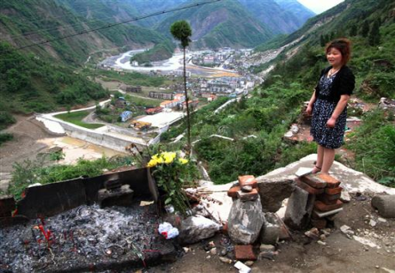
But the only thing to do after these events happen is just to rebuild. Rebuilding is the only way to get over what has happened to your life. Rebuilding cities, roads, and even your ties to the people around you. That is the only way to fix yourself after you are destroyed.

