Slide 1
A deadly hobby
By: Haleigh Stringer

Slide 2
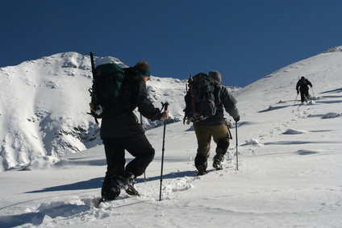
When looking down at the earth’s surface from a high altitude you expect to see that things are far below, but for some extreme hobbyist the look down is nothing but clouds. The panoramic view shows only bright blue skies. This view is the rush climbers get when they finally reach the top. High Altitude Climbing is one of the most dangerous hobbies there is. Climbers have to face numerous threats which include hyperthermia, starvation, falling, frostbite, and hypoxia. On top of the risks, climbing is very expensive also. Climbers must purchase gear and permits that can costs tens of thousands of dollars. One might ask what is the point of climbing.

Slide 3
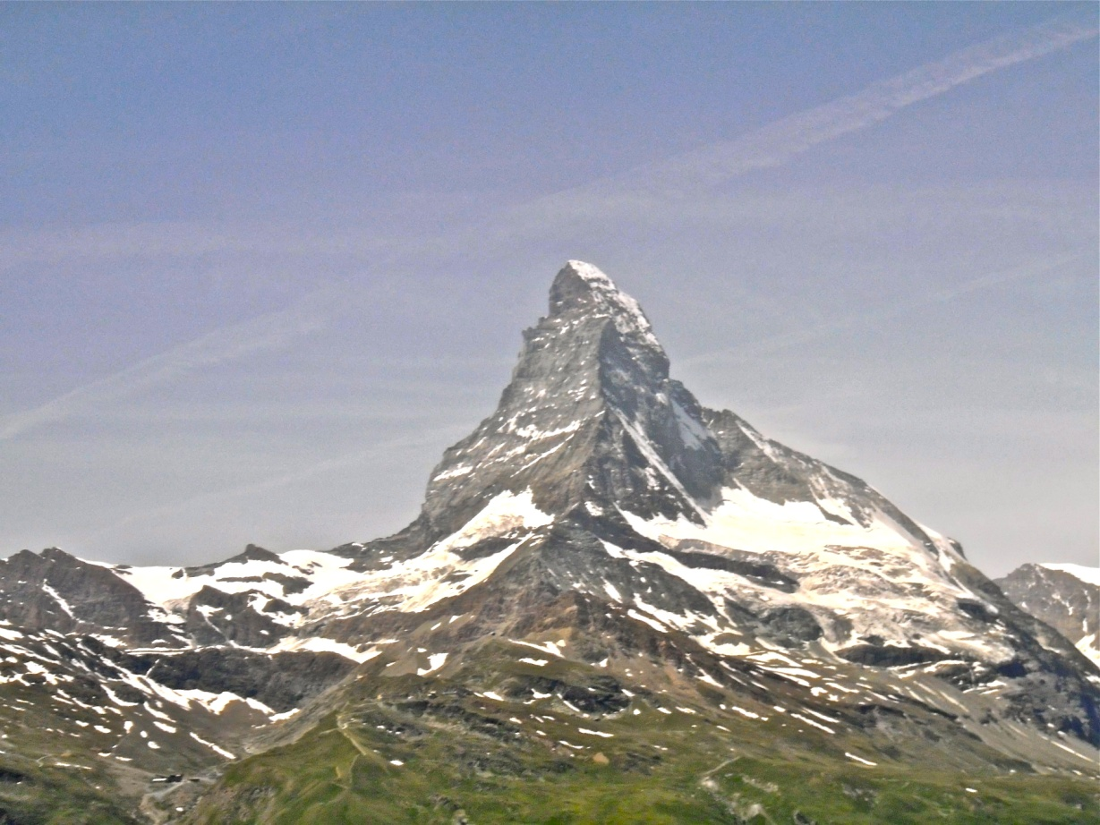
The Matterhorn is located between Switzerland and Italy. It is one of the deadliest peaks to climb in the Swiss Alps. On the first ascent alone 4 climbers fell to their death. Since 1865 over 500 climbers have died trying to make the trek.

Slide 4
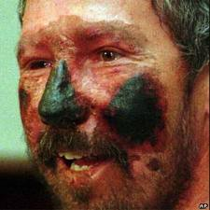
The man to the right was exposed to the cold weather while mountain climbing for so long that the tissue on his face will be permanently destroyed. Frostbite is an inevitable danger in most high altitude climbs.

Slide 5
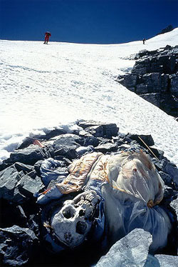
This poor guy died on his climb to the top of Mount Everest. The bodies are left where the person took their last breath. There are thousands of dead bodies littering mountains all over the globe.

Slide 6
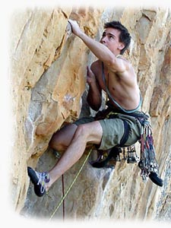
The struggle made by a climbers whole body is exemplified by this photo. Every move must be calculated and doubled checked. Any mistake could be ones last.

Slide 7
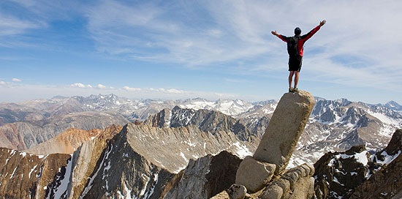
Scenes like these are the reason and reward for all the hardship, work and danger. When reaching the top a climber feels powerful, peaceful, and fulfilled. The feeling of beating nature and the accomplishment of not giving up is overwhelming. These feelings override the danger that comes with the hobby of mountain climbing.

